Slide 1

3D Game Development Week 4 – Decision making, UI/GUI & AT02!
ICTGAM423 | ICTGAM427 | ICTGAM430​
SMTAFE Thornlie | Semester 1 2023​
Ian Bell | ian.bell@smtafe.wa.edu.au​

Slide 2

Last week!
Raycasts
Provide ability to detect when we look at objects
Additional functionality allows us to detect in
Inheritance in OOP
using interfaces to create reusable functionality
DFS Pseudocode
Planning out code using flowcharts and diagrams
Working out what classes will be needed
Creating the pseudocode itself!

Slide 3
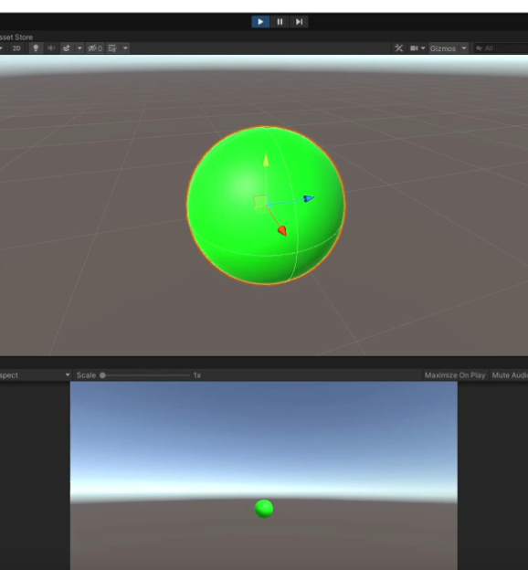
Today:
AI Decision making
FSM, BT & GOAP
Creating ‘Traffic Lights’
User Interfaces (UI/GUI)
Widgets in video games
HUDs in video games
Implementation of a GUI in Unity
Creating a simple healthbar in Unity
UGUI vs IMGUI

Slide 4
Learning Content
Artificial Intelligence
ArtificialIntelligenceForVideoGames.pdf

Slide 5
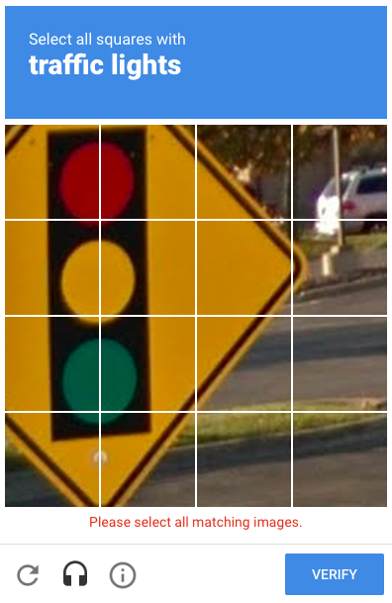
Activity – Finite State Machine // Traffic Lights

Slide 6
Learning Content
Graphical User-Interface (GUI)
HCI-UI.pdf

Slide 7
uGUI vs IMGUI
Unity GUI (uGUI)
Built in tools for creating UI in Unity
Requires a canvas object
Customizable and editable through Unity editor
Immediate Mode GUI (IMGUI)
Code driven system designed for programmers
Uses the OnGUI() function in code
Commonly used for in-game debugging displays/tools
Custom inspectors for script components
Creating new editor windows to extend Unity itself

Slide 8
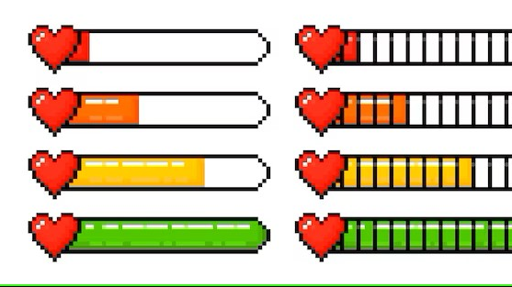
Activity – Simple Healthbar GUI

Slide 9
Next Week
Manager scripts & events in Unity
Scene management & scene transitions
Implementing UI menu functionality
At home activities
Continue work on AT01
1
Start work on AT02
2
Research & plan how to combine the FSM, traffic light system and pathfinding algorithm to simulate cars in a road system
3

